Slide 1
Creatorio
Making your complicated simple.

Slide 2
Understanding the problem
01
In the last decade, we saw a lot of platforms and businesses have emerged centered around independent content creators, curators, and freelancers. This evolution of a creator economy or passion economy has been led by media platforms such as YouTube and Instagram.
02
These creators face a major problem of managing deals & projects, accepting & managing payments, manage invoices, accept tips from fans, and many more.
03
Despite being immensely talented, many creators and influencers are not able to bring life to their ideas due to lack of resources.

Slide 3
Project objective
Creatorio is a digital marketplace made exclusively for creators and influencers providing them facilities like equipments on rent from creators near them, different resources that can help up their game in creating content.

Slide 4


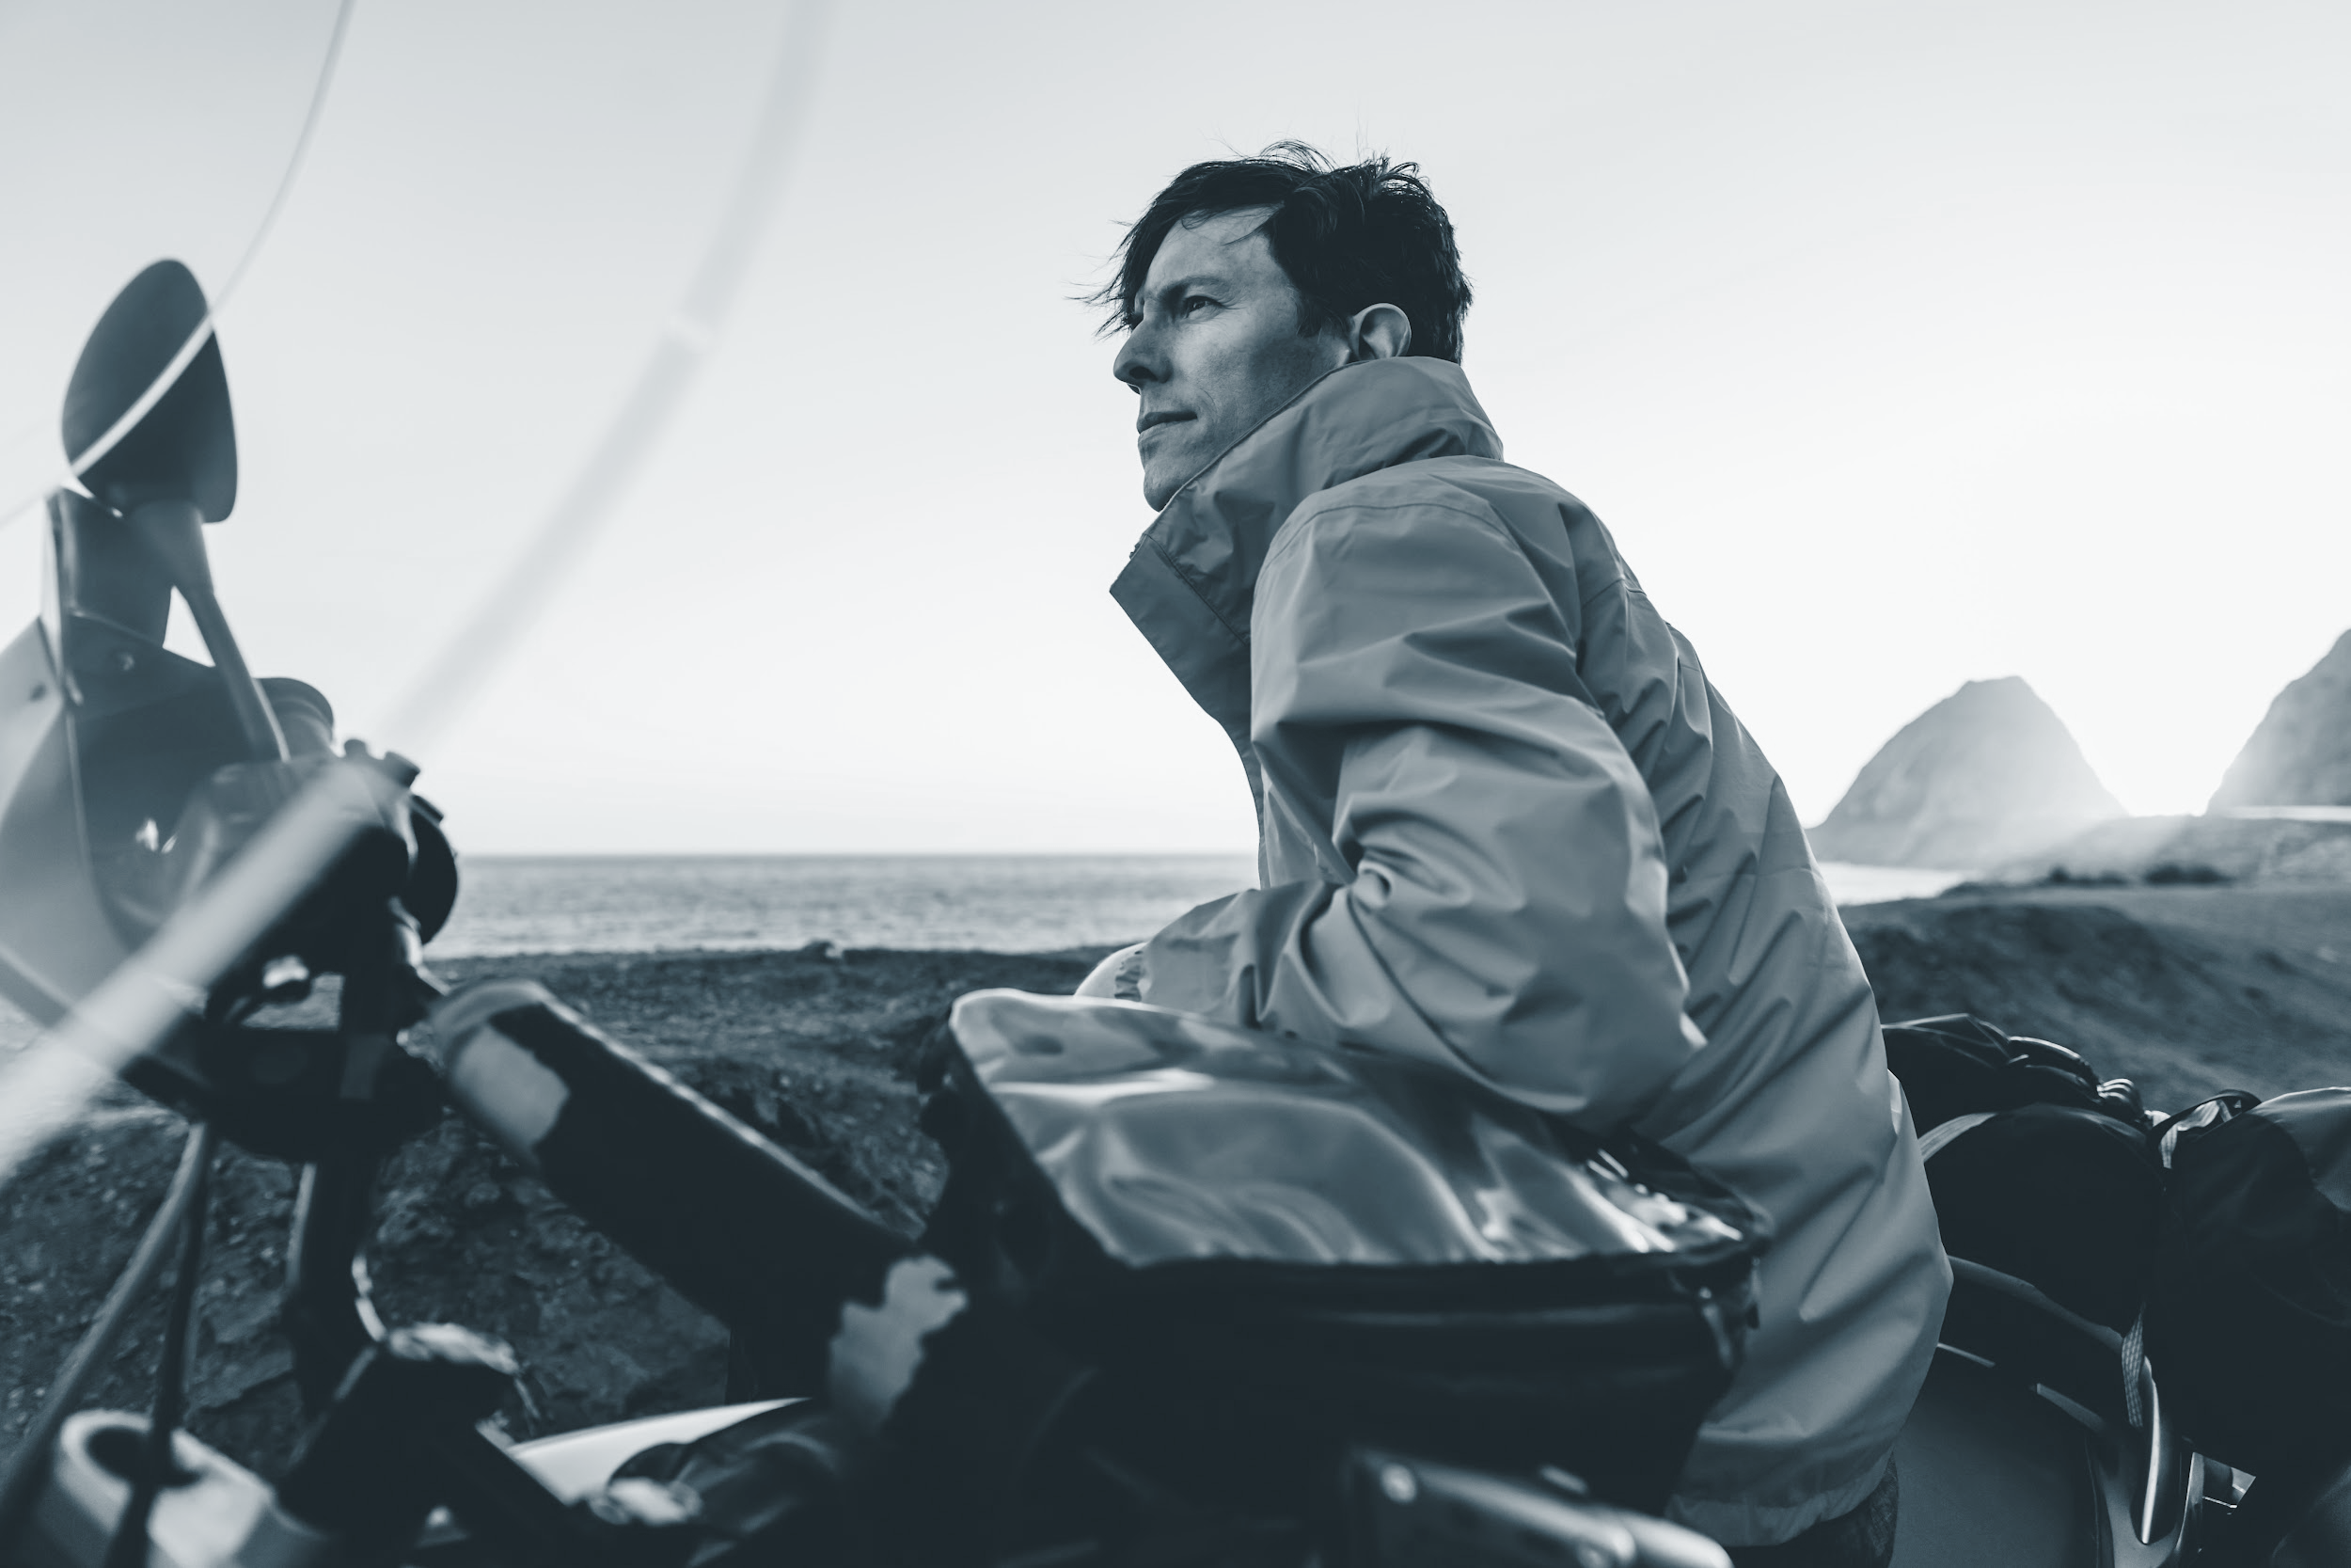
Target audience
Influencers
Creators
Youtubers

Slide 5
Introducing: Creatorio Web App

Slide 6
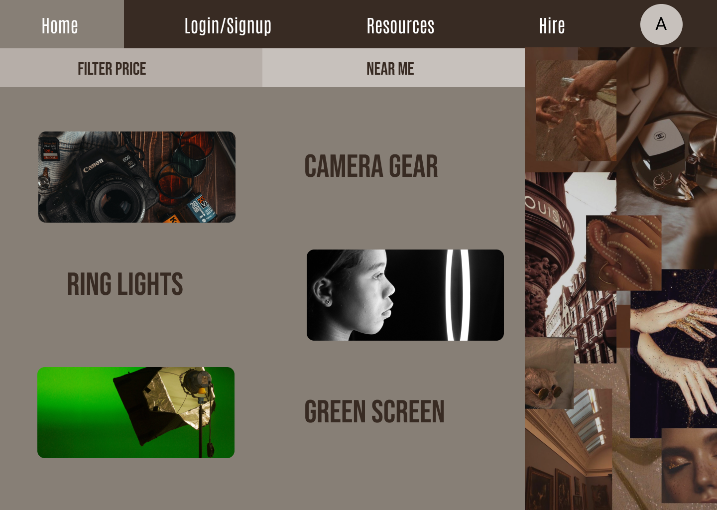
This page showcases all the equipments the creators can rent from nearby creators, while giving additional perks like filter according to prices.

Slide 7
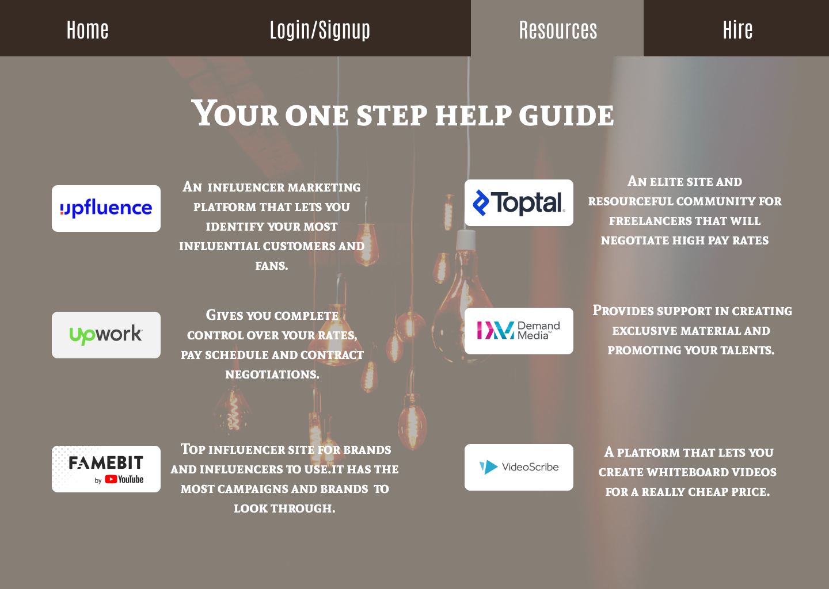
This pages provide all the resources at one place that can help creators improve their content and help them financially.

Slide 8
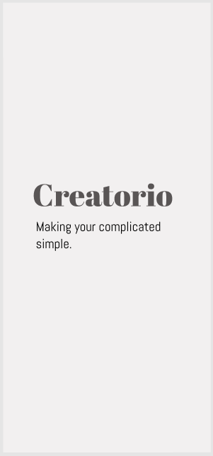
Introducing:
Creatorio Mobile App

Slide 9
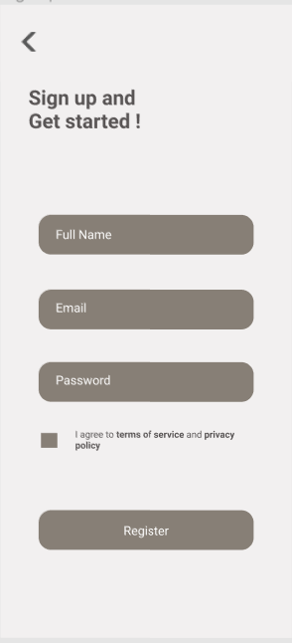
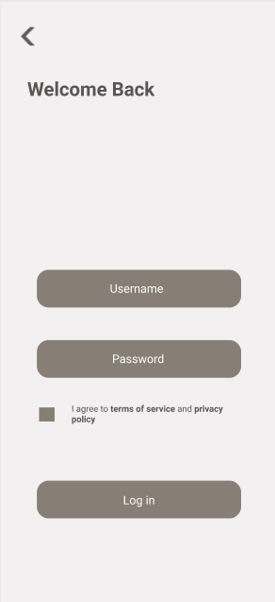

Slide 10
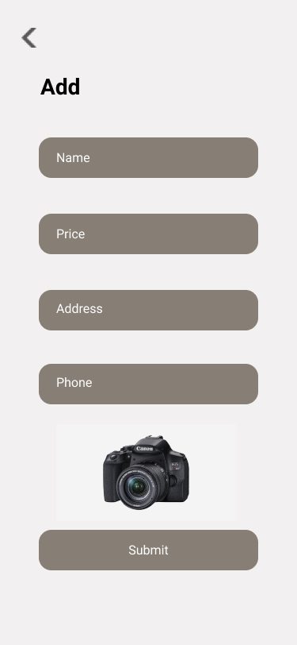
Creators can add their products for rent here.

Slide 11
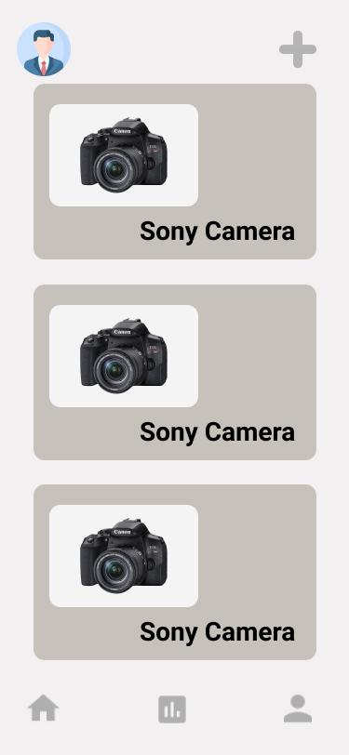
The products selected for rent are shown here.

Slide 12
Pros
01
Provides equipments on rent from other creators.
02
Compares prices of all the available products.
Provides resources which can help them improvise their ideas and skills.
03

Slide 13
Constraints
01
Anyone can register as a potent seller without authentication.
02
Privacy terms and agreements haven’t been added yet.
Creators can post multiple ads for the same product to increase the reach.
03

Slide 14
Thank
You!

